Slide 1
Global Supply Chain Management System
Subtitle: Applying SQL Skills in Database Management
Presented by:
MAHVISH KOUNAIN (NF1014902)
Tharun Kumar Reddy, Devapatla (NF1015299)
SAI KUMAR GURRAM (NF1015899)
Professor: Dr.Abbas Hamze

Slide 2

Introduction
This project aims to showcase the application of SQL database skills to develop a comprehensive and efficient database for managing a global supply chain system.
Key Points:
Project Overview:
Develop a structured and comprehensive database for a supply chain management system.
Simulate real-world scenarios to demonstrate the database's functionality and efficiency.
Objectives:
Apply SQL skills in database design, data manipulation, and data retrieval.
Ensure the database supports complex business operations within a supply chain.
Enable easy data extraction for machine learning projects, facilitating analysis and predictive modeling.
Significance:
Highlight the importance of an efficient database in managing and optimizing supply chain operations.
Demonstrate how SQL can enhance data integrity, reduce redundancy, and improve overall system performance.
Show the potential for using the database to generate valuable insights through data analysis.

Slide 3

Project Aim and Objectives
Project Aim: Develop a comprehensive SQL database for a global supply chain management system.
Objectives:
Apply SQL Skills:
Design a schema with 10+ tables.
Use DDL for creating tables and defining relationships.
Use DML for inserting, updating, and deleting data.
Use DQL for crafting queries to retrieve datasets for machine learning.
Facilitate Data Extraction for Machine Learning:
Design for easy data extraction and predictive modeling.
Demonstrate Real-World Application:
Simulate a supply chain management system.
Highlight practical benefits.

Slide 4
Database Design
Schema Development:
Developed a schema with 10 interrelated tables.
Ensured adherence to database principles to eliminate redundancy and ensure data integrity.
Key Tables and Their Relationships:
Suppliers: Information about suppliers, including SupplierID, SupplierName, and ContactDetails.
Products: Product details including ProductID, ProductName, and SupplierID.
Warehouses: Warehouse details with WarehouseID, Location, and Capacity.
Customers: Customer information such as CustomerID, CustomerName, and ContactDetails.
Orders: Order records with OrderID, CustomerID, and OrderDate.
Shipments: Shipment details including ShipmentID, OrderID, and ShippingDate.
Inventory: Inventory records with InventoryID, ProductID, and Quantity.
Employees: Employee details such as EmployeeID, EmployeeName, and Position.
Regions: Region information including RegionID and RegionName.
Transactions: Transaction records with TransactionID, OrderID, and TransactionDate.

Slide 5
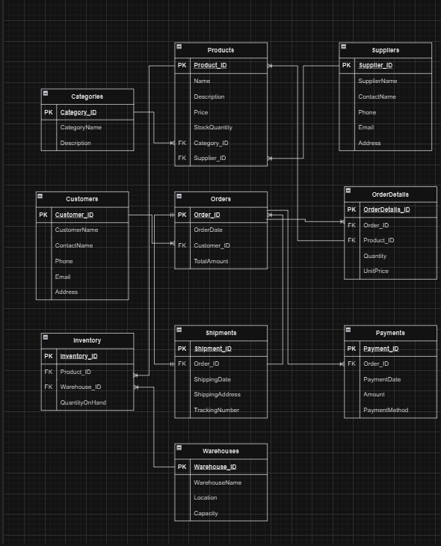
ER Diagram
LINK: https://drive.google.com/file/d/1WkMNvoNIA3xWGCJjP1dVSIfNebXpuUki/view?usp=sharing

Slide 6
Data Definition Statements (DDL)
DDL (Data Definition Language) Commands are SQL commands used to define, modify, or remove database structures, such as tables, indexes, and schemas. DDL commands do not manipulate data but focus on the structure of the database itself.
DDL commands are essential for defining and structuring the database.
Creating Tables and Defining Relationships:
Utilized DDL statements to create the tables necessary for the supply chain management system.
Defined relationships between tables using primary and foreign keys.
Key Constraints Enforced:
Primary Keys: Ensuring unique identification of records in each table.
Foreign Keys: Establishing links between related tables.
Unique Constraints: Guaranteeing the uniqueness of specific columns.
Not Null Constraints: Ensuring essential fields are not left empty.
Check Constraints: Enforcing domain-specific rules on data values.

Slide 7
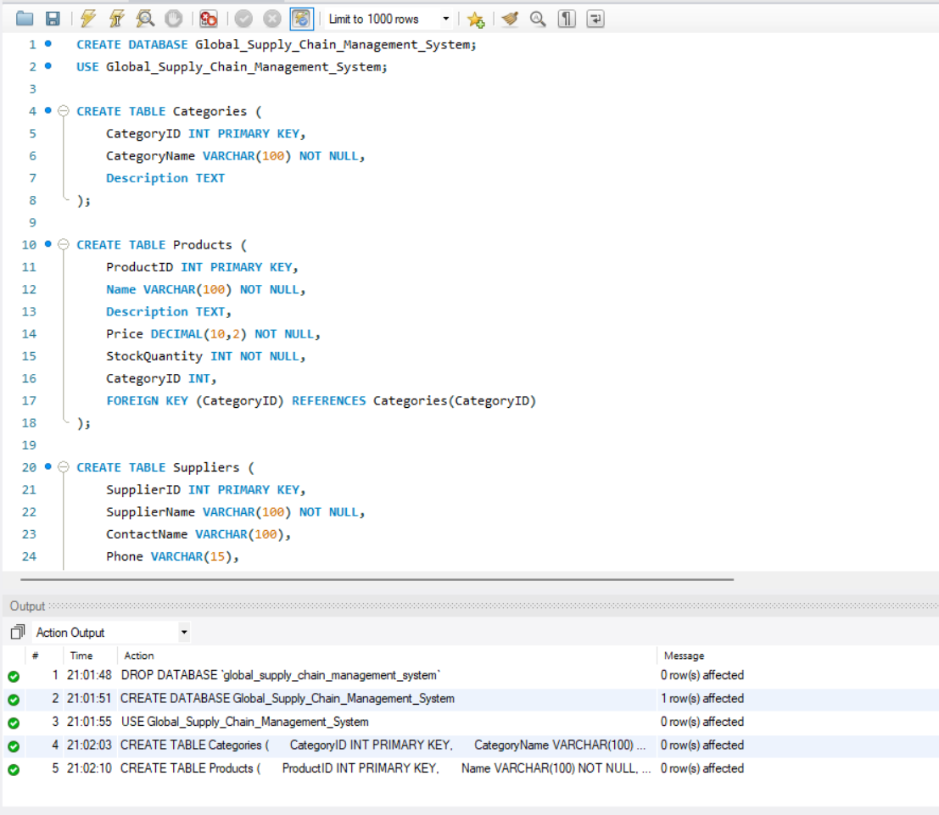
DDL Statements for creating the tables
/*create table for categories*/
CREATE TABLE Categories (
CategoryID INT PRIMARY KEY,
CategoryName VARCHAR(100) NOT NULL,
Description TEXT
);
/* create table for products*/
CREATE TABLE Products (
ProductID INT PRIMARY KEY,
Name VARCHAR(100) NOT NULL,
Description TEXT,
Price DECIMAL(10,2) NOT NULL,
StockQuantity INT NOT NULL,
CategoryID INT,
FOREIGN KEY (CategoryID) REFERENCES Categories(CategoryID)
);

Slide 8

Data Manipulation Statements (DML)
DML (Data Manipulation Language) commands are SQL commands used for managing and manipulating data within database tables. Unlike DDL (Data Definition Language) commands, which define and structure the database, DML commands are used to insert, update, delete, and retrieve data stored in those tables.
DML commands helps to perform operations on actual data within the database tables.
Populating Tables with Realistic Data:
Insert data into tables to simulate real-world scenarios.
Ensure data reflects dynamic management within the supply chain.
Using DML Statements:
Insert Records: Add new records to the database.
Update Records: Modify existing records to reflect changes.
Delete Records: Remove records that are no longer needed.

Slide 9
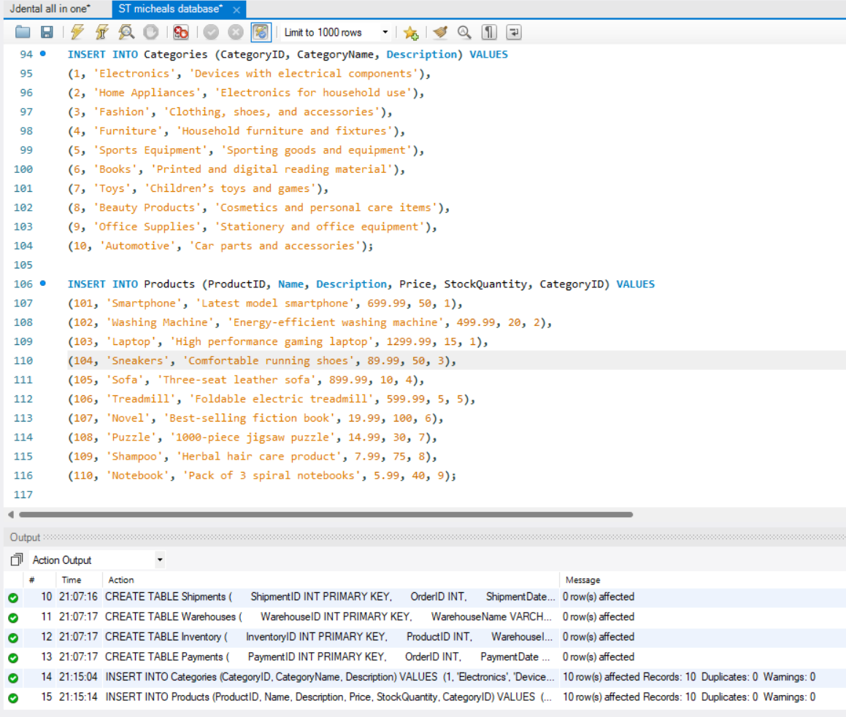
Inserting the values by using DML Statements
INSERT INTO Categories (CategoryID, CategoryName, Description) VALUES
(1, 'Electronics', 'Devices with electrical components’),
(2, 'Home Appliances', 'Electronics for household use’),
(3, 'Fashion', 'Clothing, shoes, and accessories’),
(4, 'Furniture', 'Household furniture and fixtures’),
(5, 'Sports Equipment', 'Sporting goods and equipment’),
(6, 'Books', 'Printed and digital reading material’),
(7, 'Toys', 'Children’s toys and games’),
(8, 'Beauty Products', 'Cosmetics and personal care items’),
(9, 'Office Supplies', 'Stationery and office equipment’),
(10, 'Automotive', 'Car parts and accessories’);
INSERT INTO Products (ProductID, Name, Description, Price, StockQuantity, CategoryID) VALUES
(101, 'Smartphone', 'Latest model smartphone', 699.99, 50, 1),
(102, 'Washing Machine', 'Energy-efficient washing machine', 499.99, 20, 2),
(103, 'Laptop', 'High performance gaming laptop', 1299.99, 15, 1),
(104, 'Sneakers', 'Comfortable running shoes', 89.99, 50, 3),
(105, 'Sofa', 'Three-seat leather sofa', 899.99, 10, 4),
(106, 'Treadmill', 'Foldable electric treadmill', 599.99, 5, 5),
(107, 'Novel', 'Best-selling fiction book', 19.99, 100, 6),
(108, 'Puzzle', '1000-piece jigsaw puzzle', 14.99, 30, 7),
(109, 'Shampoo', 'Herbal hair care product', 7.99, 75, 8),
(110, 'Notebook', 'Pack of 3 spiral notebooks', 5.99, 40, 9);

Slide 10

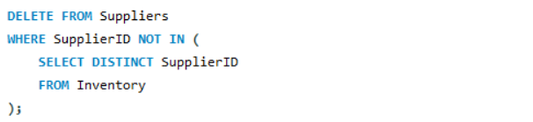
DML commands for UPDATE and DELETE
UPDATE
DELETE
UPDATE Orders
SET TotalAmount = 1299.99
WHERE
OrderID = 6;
DELETE FROM Suppliers
WHERE SupplierID NOT IN (
SELECT DISTINCT SupplierID
FROM Inventory
);

Slide 11

Data Query Language (DQL)
DQL (Data Query Language) is a subset of SQL that is used to query and retrieve data from a database. It focuses on SELECT statements to extract data from one or more tables in a database. DQL does not modify data, but it helps in querying and analyzing data.
Crafting SQL Queries to Retrieve Data:
Selecting Specific Records: Use SELECT statements to retrieve data from one or more tables.
Joining Multiple Tables: Use JOIN operations to combine data from related tables.
Grouping Data: Use GROUP BY clauses to organize data into groups for aggregation.
Performing Aggregate Calculations: Use functions like COUNT, SUM, AVG, MAX, and MIN to perform calculations on grouped data.

Slide 12
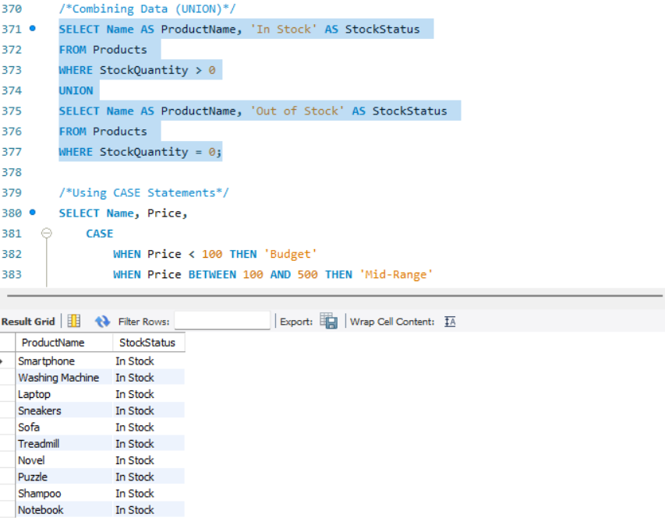
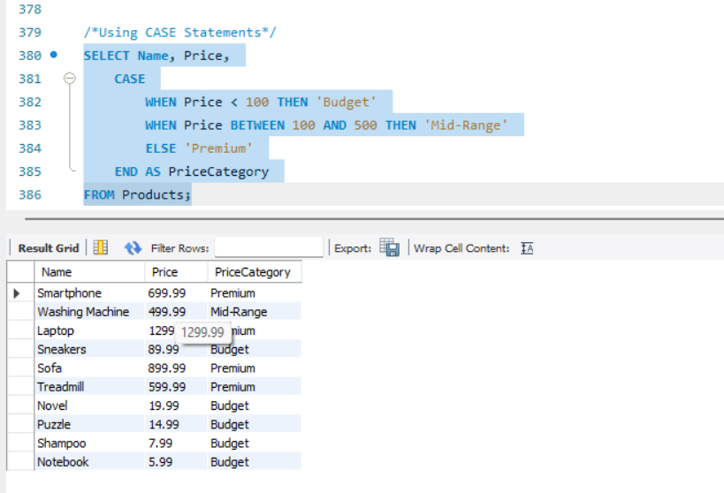
Example of DQL statements
/*Combining Data (UNION)*/
SELECT Name AS ProductName, 'In Stock' AS StockStatus
FROM Products
WHERE StockQuantity > 0
UNION
SELECT Name AS ProductName, 'Out of Stock' AS StockStatus
FROM Products
WHERE StockQuantity = 0;
/*Using CASE Statements*/
SELECT Name, Price,
CASE
WHEN Price < 100 THEN 'Budget'
WHEN Price BETWEEN 100 AND 500 THEN 'Mid-Range'
ELSE 'Premium'
END AS PriceCategory
FROM Products;

Slide 13
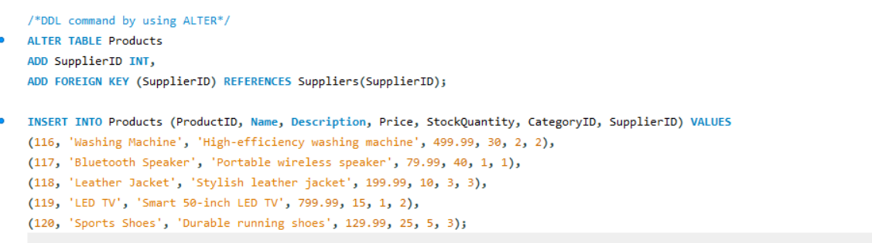
/*DDL command AND DML command to update a table*/
ALTER TABLE Products
ADD SupplierID INT,
ADD FOREIGN KEY (SupplierID) REFERENCES Suppliers(SupplierID);

Slide 14

Machine Learning Datasets
Preparing Datasets for Machine Learning:
Designing for Easy Data Extraction:
Structure the database to allow seamless data extraction.
Ensure relevant data is easily accessible for analysis.
Creating Sample Datasets:
Prepare datasets from the database for machine learning projects.
Include various data points such as supplier performance, inventory levels, order fulfillment times, and customer satisfaction metrics.
Data for Analysis and Predictive Modeling:
Extract data that can be used for training machine learning models.
Focus on data points that help in predictive analytics, such as forecasting demand, optimizing inventory, and improving supply chain efficiency.

Slide 15

Example SQL Queries for Data Extraction
-- Extracting supplier performance data
SELECT SupplierID, AVG(DeliveryTime) AS AverageDeliveryTime
FROM Shipments
GROUP BY SupplierID;
-- Extracting inventory levels
SELECT WarehouseID, ProductID, Quantity
FROM Inventory
WHERE Quantity < 50;
-- Extracting order fulfillment times
SELECT OrderID, DATEDIFF(DeliveryDate, OrderDate) AS FulfillmentTime
FROM Orders
JOIN Shipments ON Orders.OrderID = Shipments.OrderID;
-- Extracting customer satisfaction metrics
SELECT CustomerID, COUNT(OrderID) AS OrdersPlaced, AVG(FeedbackRating) AS AverageRating
FROM Orders
JOIN CustomerFeedback ON Orders.OrderID = CustomerFeedback.OrderID
GROUP BY CustomerID;

Slide 16
Practical Implementation
Simulation of Real-World Supply Chain Management System:
Implement the database in a simulated environment to test its functionality.
Demonstrate how the database can be used to manage and optimize supply chain operations.
Real-World Application and Benefits:
Improved Efficiency: Streamline supply chain operations by providing accurate and timely information.
Enhanced Decision-Making: Enable data-driven decision-making through comprehensive data analysis and reporting.
Optimized Inventory Management: Maintain optimal inventory levels by tracking stock movements and predicting demand.
Better Supplier Management: Monitor supplier performance and ensure timely deliveries.
Customer Satisfaction: Improve order fulfillment processes, leading to higher customer satisfaction.

Slide 17
Conclusion and Future Work
Summary of Project Achievements:
Developed a comprehensive SQL database for a global supply chain management system.
Applied SQL skills in database design, data manipulation, and data retrieval.
Demonstrated the practical implementation and benefits of the developed database.
Key Takeaways:
The importance of a well-designed database in managing and optimizing supply chain operations.
The role of SQL in ensuring data integrity, facilitating data extraction, and supporting decision-making.
The potential for using the database to generate valuable insights through data analysis and machine learning.
Future Work:
Database Expansion: Adding more tables and data to cover additional aspects of the supply chain.
Integration: Integrating the database with other systems such as ERP and CRM for a more holistic approach.
Advanced Analytics: Utilizing machine learning models to predict demand, optimize inventory, and improve overall efficiency.
User Interface: Developing a user-friendly interface to make the database accessible to non-technical users.
Real-World Testing: Implementing the database in a real-world environment to validate its effectiveness and gather feedback for further improvement.

Slide 18
Thank you!!

